Slide 1
Project Benson
Benjamin, Chun, Meena, Nazim

Slide 2
Executive Summary
Background:
WomenTechWomenYes (WTWY) has an annual gala at the beginning of the October. We need to fill event space with individuals passionate about increasing the participation of women in technology, and concurrently build awareness and reach.
Objective:
How and when do we engage the street teams of WomenTechWomenYes (WTWY) in entrances to subway stations such that they reach maximum number of people and get most signatures?
Findings:
The top 5 stations for the weekend are different from those for the weekday

Slide 3
Methodology
MTA Turnstile data for one week (September 16th 2018 to September 22nd 2018) was used to analyze the entries and exits from a station
Calculated net traffic as Entries+Exits
Removed outliers that indicate a broken turnstile
Obtained the top 10 stations that have highest traffic within a 24 hour window and on different days of the week
Aggregated traffic in 4-hour timeslots
Compared the demographics of the zipcodes of the top ten stations based on entries and exits

Slide 4
Net traffic for all stations over 4 weeks
There is a 5.4% difference between the top station(5.1M) and the second highest station(4.85M) based on net traffic
Station1(34-PENN ST) makes up for ~4% of the total traffic across all stations over a 4-week period.
Top 10 stations contribute to ~26%(33M) of total traffic
4pm – 8 pm slot has the highest flow of traffic(~30%) overall

Slide 5
Top 5 Stations based on day of the week

Slide 6
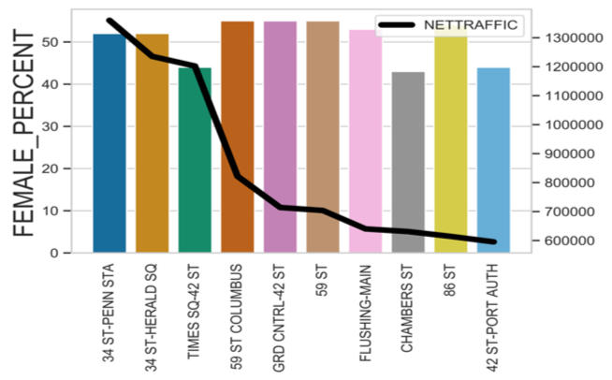
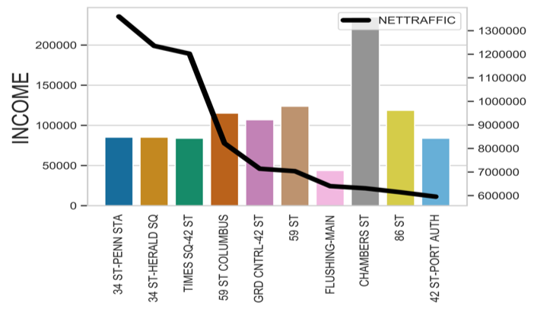
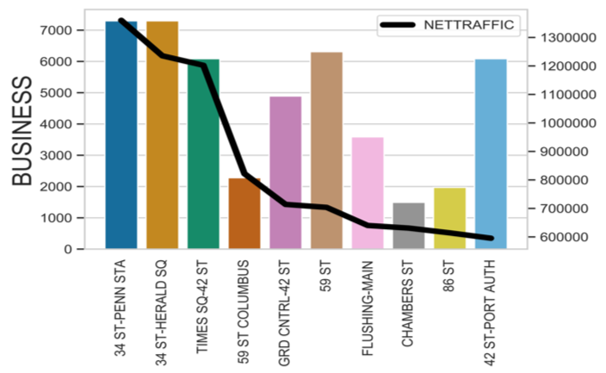
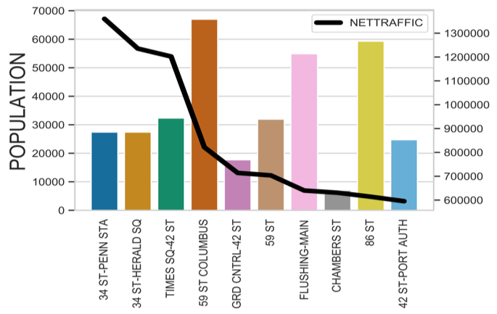
Demographic information for the zip codes of the top 10 stations based on net traffic
% of Female population vs. net traffic
Median income vs. net traffic
Number of business vs. net traffic
Total Population vs. net traffic

Slide 7
Calculation of number of participants based on reach in the top 10 stations and assumed turnout
 | REACH
STATION | 5% | 10% | 15% | 20%
34 ST-PENN STA | 256,065 | 512,129 | 768,194 | 1,024,259
34 ST-HERALD SQ | 242,918 | 485,836 | 728,754 | 971,673
TIMES SQ-42 ST | 233,060 | 466,120 | 699,180 | 932,240
59 ST COLUMBUS | 154,669 | 309,339 | 464,008 | 618,677
GRD CNTRL-42 ST | 148,527 | 297,054 | 445,580 | 594,107
59 ST | 134,267 | 268,534 | 402,801 | 537,068
FLUSHING-MAIN | 125,818 | 251,637 | 377,455 | 503,274
CHAMBERS ST | 121,907 | 243,815 | 365,722 | 487,630
47-50 STS ROCK | 117,726 | 235,452 | 353,178 | 470,904
42 ST-PORT AUTH | 116,394 | 232,787 | 349,181 | 465,575
TOTAL | 1,651,352 | 3,302,703 | 4,954,055 | 6,605,406
ASSUME TURNOUT | 1%
ASSUMED REACH | 5%
PARTICIPATION | 16,514

Slide 8
Recommendations
We recommend placing teams on these days in the following stations
We recommend the following hours for placement to maximize reach

Slide 9
The top three stations with high number of businesses have highest entries in the evening(4-8pm)
Appendix
Number of business vs. evening entries(4-8pm)

